Slide 1
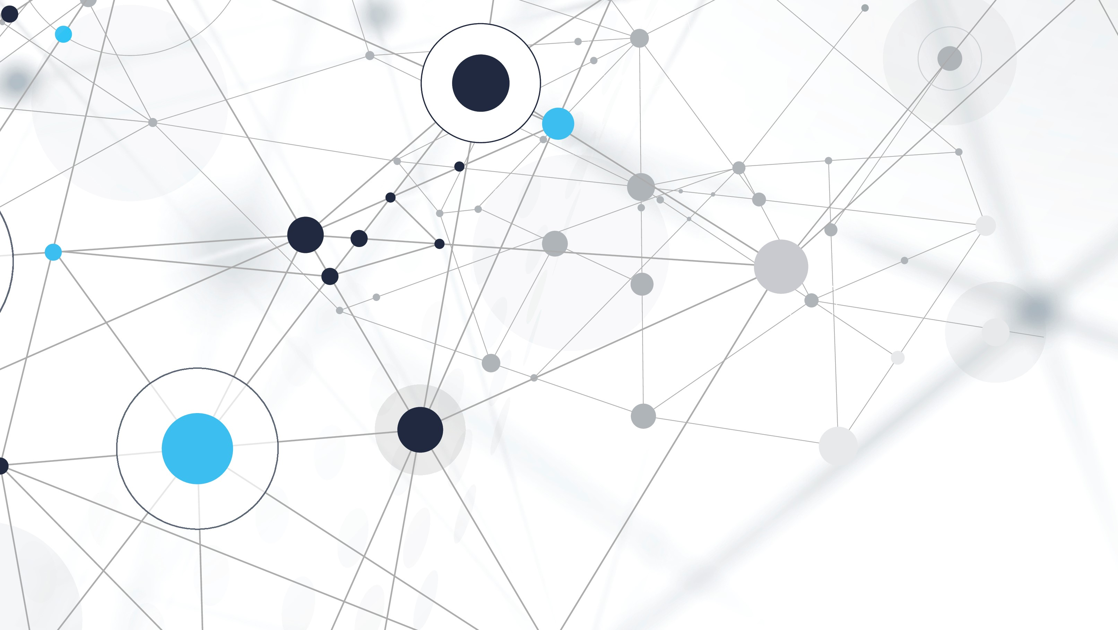
Heart health management
Using Machine Learning

Slide 2
TEAM introduction
Project code: W2020-05
Project Supervisor: Sir Ahmad Saeed
Syed Hasnain Meesam
70068997
Muhammad Ahmed Sohail
70069006
Muhammad Saad Adil
70068883

Slide 3
Work division
Research Work + Documentation
App Development + Machine learning

Slide 4
introduction
As the most frequent cause of death worldwide, cardiovascular disease (CVD) is constantly emerging.
According to the annual report 2019 of PIMS (Pakistan Institute of Medical Sciences) about 30-40% of the population of Pakistan is suffering from cardiovascular diseases.
Studies infers that coronary heart disease is leading cause of death in Pakistan which means at least 12 Pakistani die every hour due to cardiac arrest.

Slide 5
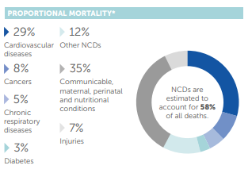
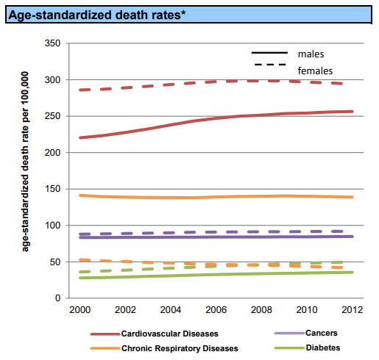
Problem Severity
According to the pie chart from WHO report, 29% of deaths are due to Cardiovascular Diseases
The death-rate in Pakistan due to heart attacks has significantly increased.

Slide 6
Common Problems
Not knowing when a heart attack happens
Not receiving proper medical help immediately
No facility of a system for helping the person knowing whether they’re at risk or not
Not keeping a track on their health conditions

Slide 7
Problem statement
This project aims at providing a solution to one of the major problems that is prevalent in world that is providing assistance to people suffering from cardiovascular diseases by using heart rate data gathered from MI bands and patient medical history data.

Slide 8
Targeted Users
First user group of our software would be the users of Mi Band
Patients who are almost always at risk of cardiovascular diseases

Slide 9
Previous work in the domain
Apple : ‘Apple heart study’ in partnership Stanford medicine
Fitbit : Fitbit is a fitness tracker currently available in the market which is used to track heart rate, sleep time, calories, steps, oxygen, optimizes exercise etc.
Samsung : Samsung gear watches are used to monitor heart rate.

Slide 10
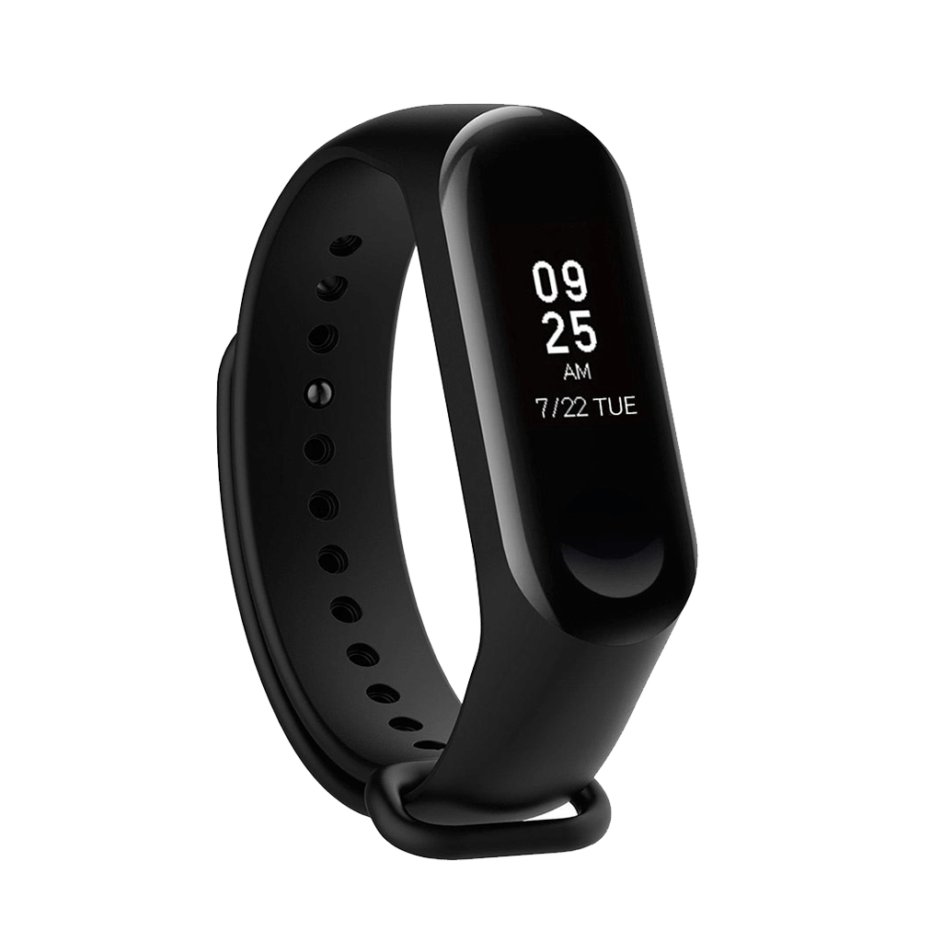
SMART Watch of interest
Xiaomi Mi Band:
Heart rate reading (±5 Accuracy)
Steps
Connection via Bluetooth(BLE)
Low cost

Slide 11
Approach
Connect the band via BLE through the application
Gather heart rate data from the Mi band
Get movement data on the phone
Get patients biographical attributes
Analysis of the data collected
Determining whether the user is at risk or not

Slide 12
Biographical Attributes
Age
Sex
Cholesterol Level
Blood Pressure
Heart Rate
Height
Weight

Slide 13
Classification algorithms
KNN
Naïve Bayes
SVM
Adaboost
Random Forest
Trees

Slide 16
Why support vector machine (svm)?
We choose support vector machine because it gives the best accuracy than all other algorithms.
SVM is also better because it works very well with a clear margin of separation.
SVM tend to be resistant to overfitting
SVM is more precise because the recall value we’re getting out of it is 1, while precision being 0.8 and F1-score being 0.89, where threshold is 0.4

Slide 17
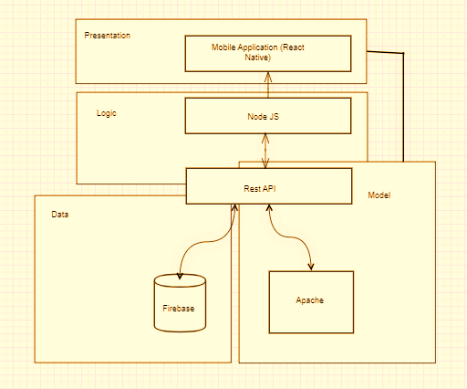
Architecture diagram

Slide 18
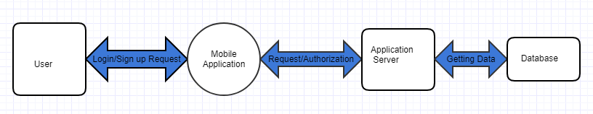
Data flow diagram
Level 0

Slide 19
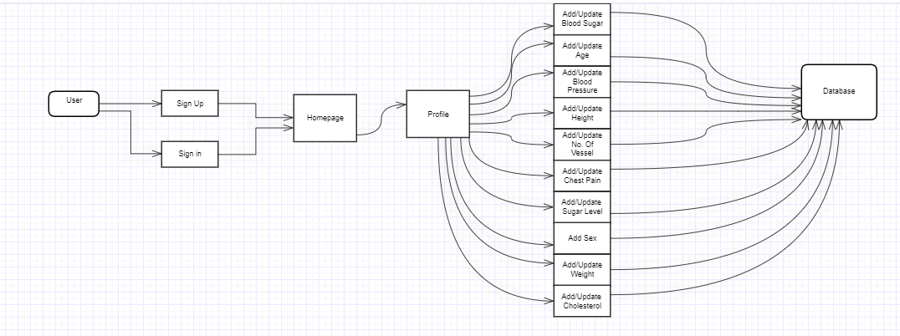
Data flow diagram
Level 1

Slide 20
Technologies in Mobile App
React Native
Redux (for state management)
Firebase
Apache

Slide 21
Why react native?
Time and cost efficiency
Faster to build
One framework, multiple platforms
Fast applications
Fast refresh
Sharing the codebase for iOS, Android, and the Web (with ReactXP and React Native for Web)

Slide 22
redux
Redux is a predictable state container for JavaScript apps.
It helps you write applications that behave consistently, run in different environments (client, server, and native), and are easy to test. On top of that, it provides a great developer experience.

Slide 23
firebase
Firebase is Google’s platform for mobile and web development that helps entrepreneurs build, improve, and scale their app products. The platform offers a set of tools that make the product development process a lot easier.
Database options
Free

Slide 24
Challenges
Connect Mi band with App
Python script run on a server
Make a responsive Api

Slide 25
achievements
Problem solving
Team work
Time management

Slide 26
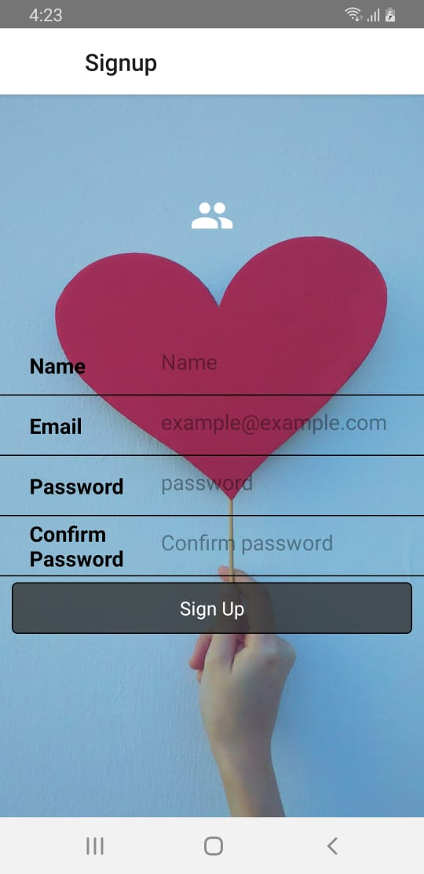
Application interface
Sign Up

Slide 27
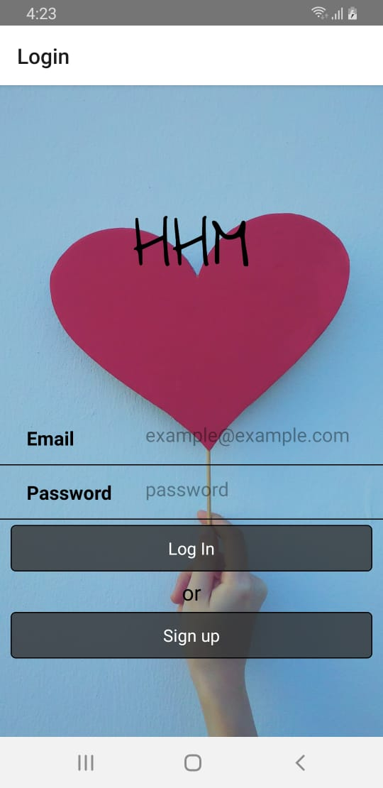
Login

Slide 28
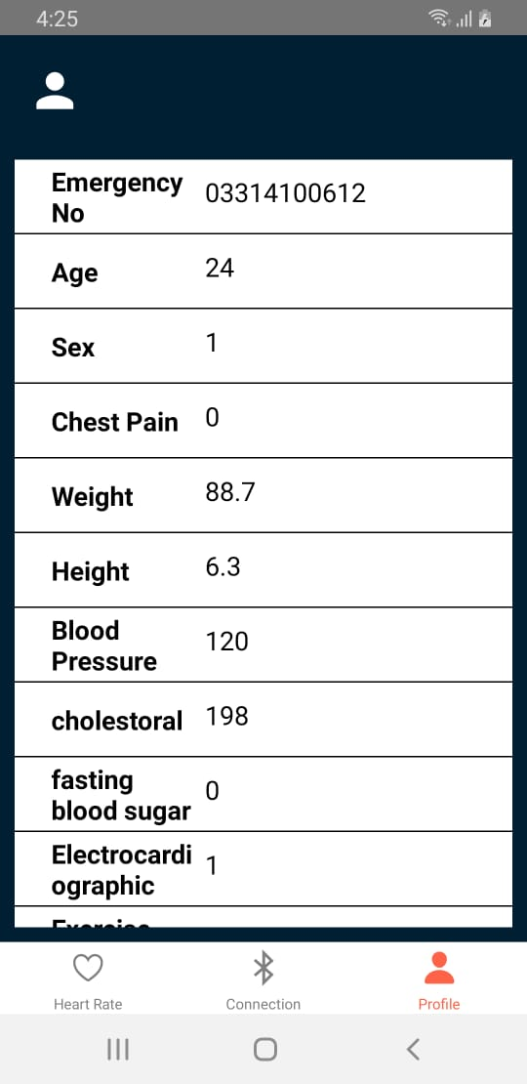
User Profile

Slide 29
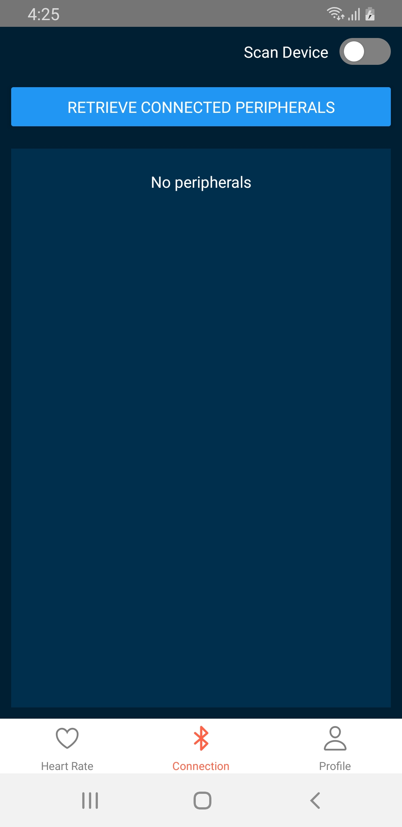
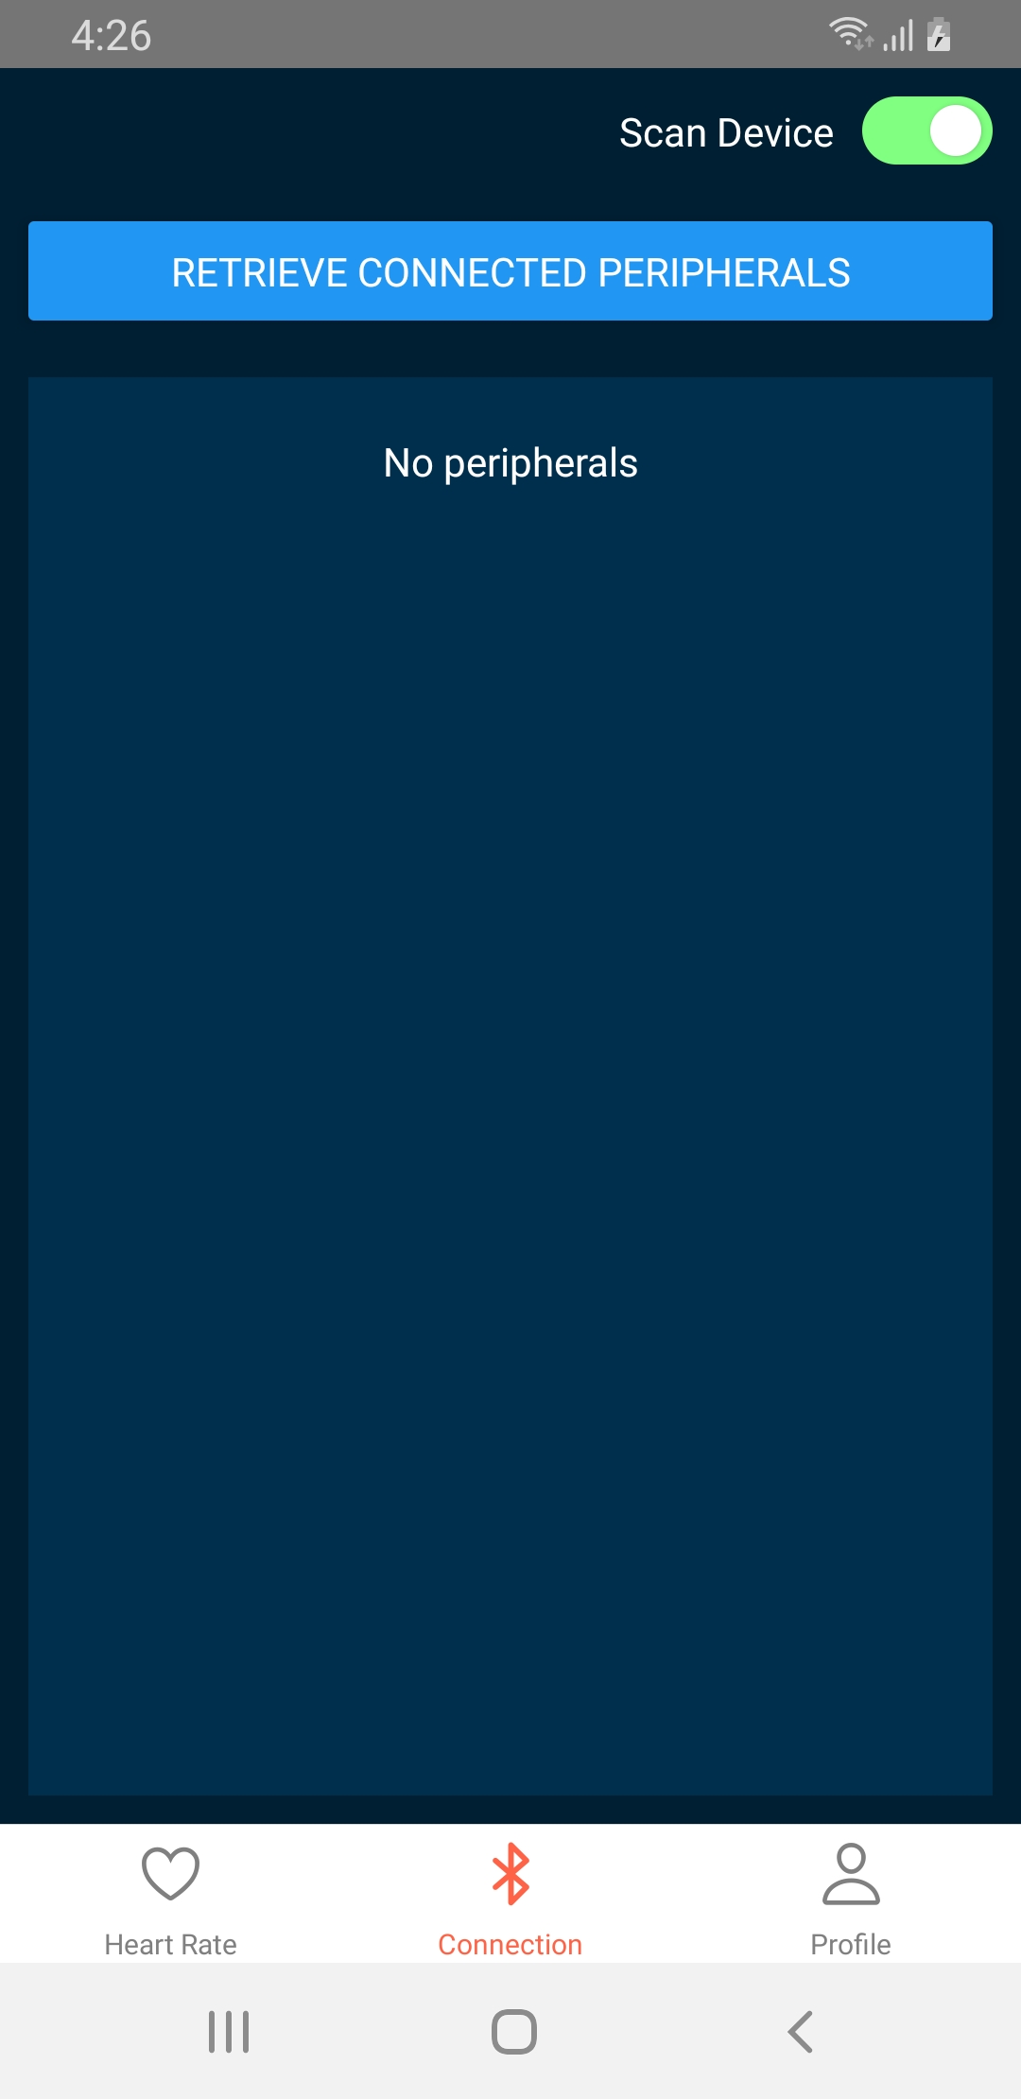
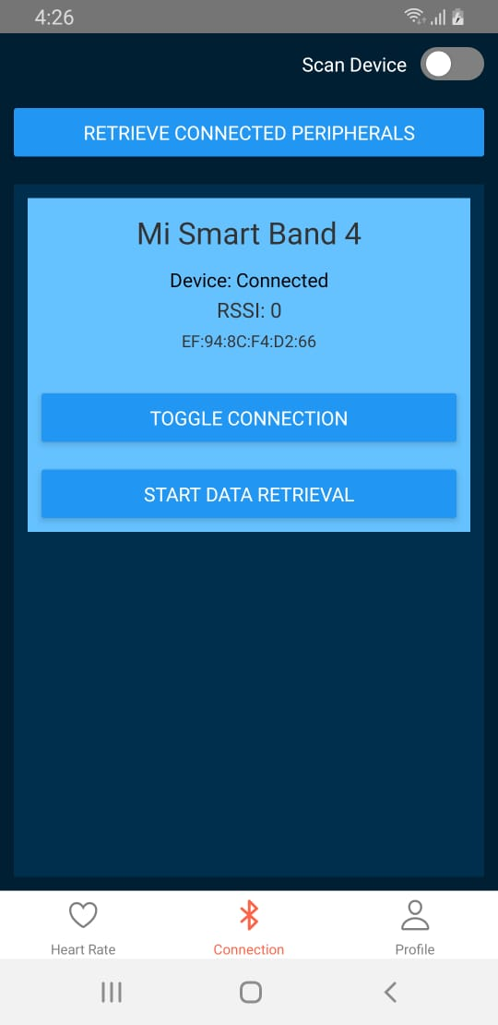
Connectivity

Slide 30
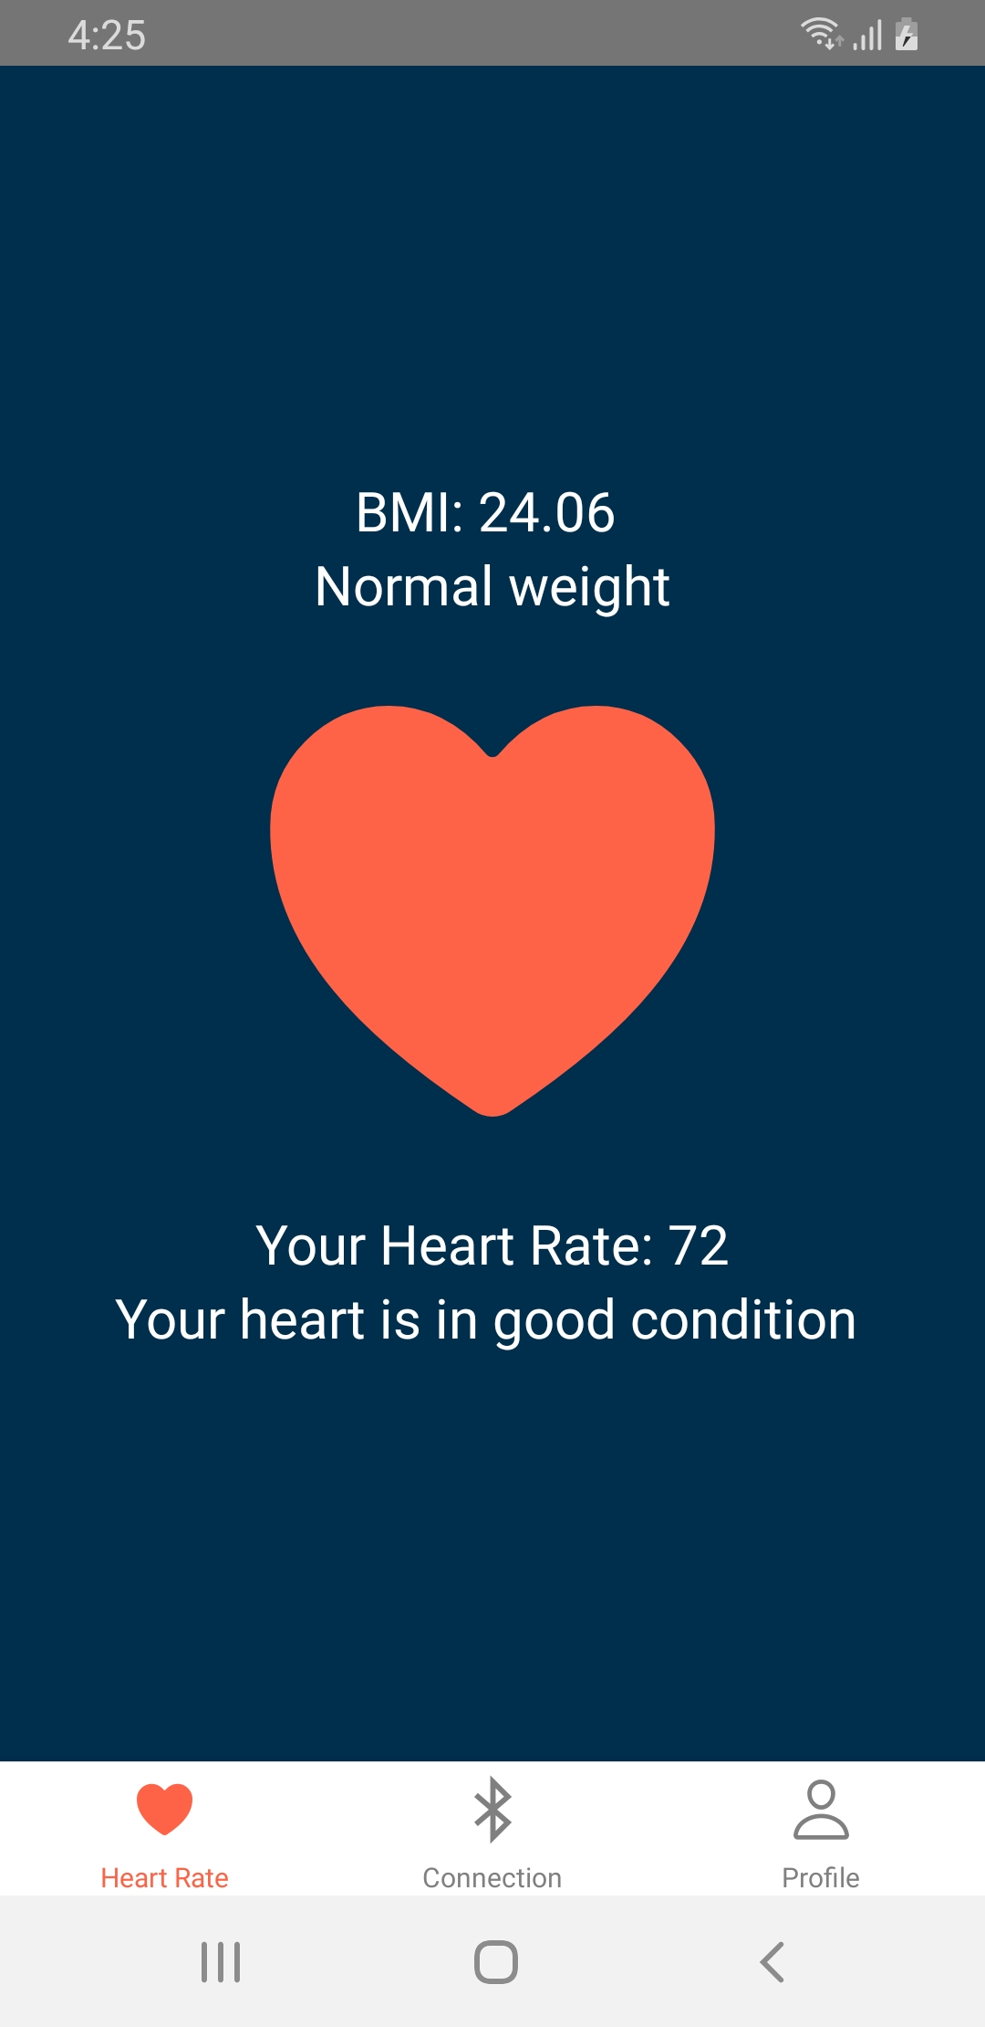
Heart Rate

Slide 31
References
http://www.shifa.com.pk/files/pdf/ar_20171009.pdf
http://www.who.int/nmh/countries/pak_en.pdf
https://www.shifa.com.pk/chronic-disease-pakistan/
https://www.dawn.com/news/1046114
http://www.who.int/nmh/countries/pak_en.pdf
https://www.dawn.com/news/1046114
http://www.samsung.com/us/heartratesensor/
https://www.apple.com/watch/apple-heart-study/
http://www.mdpi.com/2075-4426/7/2/3/pdf
http://med.stanford.edu/appleheartstudy.html
https://www.fitbit.com/purepulse

